Slide 1

Data structure & Algorithm
Name: Alamin
Master of Science in Computer Science (MSCS)
American International University of Bangladesh (AIUB)

Slide 2
Outline
What is data structure & algorithm?
What is data structure?
Why we need data structure?
Types of data structure?
Where to use which data structure?

Slide 3
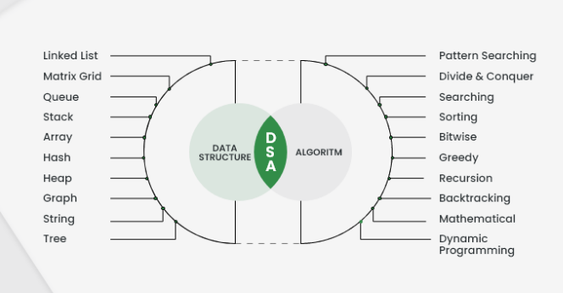
What is data structure & algorithm?
DSA is defined as a combination of two separate yet interrelated topics – Data Structure and Algorithms. DSA is one of the most important skills that every computer science student must-have. It is often seen that people with good knowledge of these technologies are better programmers than others.

Slide 4

What is data structure?
A data structure is a way of organizing and storing data in a computer or a programming language, enabling efficient access, manipulation, and management of the information it contains.
Why we need data structure?
Data structures are essential in computer science and programming because they provide a systematic and organized approach to storing and managing data, allowing for efficient operations and problem-solving. Without data structures, the handling of information would be chaotic and inefficient, leading to significant challenges in designing algorithms, managing memory, and processing data.

Slide 5
Why we need data structure?
Imagine a scenario where data is randomly scattered throughout the computer's memory with no specific order or structure. In such a situation, searching for a specific piece of information or performing common operations like insertion, deletion, or sorting would be extremely time-consuming and error-prone. Data structures address this problem by defining rules and techniques for organizing data in a logical manner, ensuring that the data can be accessed and modified with ease and speed.
By utilizing data structures, programmers can optimize their algorithms and design efficient solutions for various computational problems. For instance, using an appropriate data structure, such as arrays, linked lists, trees, or hash tables, allows for faster searching, sorting, and retrieval of data, reducing the time and resources needed to perform specific tasks. Additionally, data structures help manage memory efficiently by allocating memory space as required and deallocating it when no longer needed, preventing memory wastage and fragmentation.
Furthermore, data structures facilitate the creation of reusable and modular code, as they provide standardized methods for interacting with the stored data. This modularity enhances code readability and maintainability, making it easier for developers to collaborate and improve software over time.

Slide 6
Data structure two types:
Linear Data Structure
Static data structure
Array
Dynamic data structure
Queue
Stack
Linked list
Non-linear Data Structure
Tree data structure
Graph data structure
Types of data structure?

Slide 7
Types of data structure?
Linear data structure: Data structure in which data elements are arranged sequentially or linearly, where each element is attached to its previous and next adjacent elements, is called a linear data structure. Examples of linear data structures are array, stack, queue, linked list, etc.
Static data structure: Static data structure has a fixed memory size. It is easier to access the elements in a static data structure. An example of this data structure is an array.
Dynamic data structure: In dynamic data structure, the size is not fixed. It can be randomly updated during the runtime which may be considered efficient concerning the memory (space) complexity of the code. Examples of this data structure are queue, stack, etc.
Non-linear data structure: Data structures where data elements are not placed sequentially or linearly are called non-linear data structures. In a non-linear data structure, we can’t traverse all the elements in a single run only.
Examples of non-linear data structures are trees and graphs.

Slide 8
Where to use which data structure?
The choice of data structure depends on the specific requirements and characteristics of the problem or task you are trying to solve. Each data structure has its own strengths and weaknesses, and selecting the right one can significantly impact the efficiency and performance of your program. Here are some guidelines on where to use which data structure:
Arrays:
Use arrays when you have a fixed size of data and need direct access to elements using an index.
Suitable for simple lists or collections where elements are accessed frequently by their positions.
They offer constant time access to elements, but insertion and deletion can be inefficient.
Linked-List:
Use linked lists when you require dynamic memory allocation and can tolerate slower element access but faster insertion and deletion.
Suitable for situations where you frequently insert or remove elements from the beginning, middle, or end of the list.

Slide 9
Where to use which data structure?
Stack:
Use stacks when you need a Last-In-First-Out (LIFO) data structure.
Suitable for implementing function calls, parsing expressions, and undo functionalities.
Queues:
Use queues when you need a First-In-First-Out (FIFO) data structure.
Suitable for tasks like scheduling, task management, breadth-first search, etc.
Trees:
Use trees when you need hierarchical data representation, like in directory structures, hierarchical databases, or parsing expressions.
Suitable for implementing binary search trees (BST) for efficient searching, insertion, and deletion.

Slide 10
Where to use which data structure?
Graphs:
Use graphs when you have complex relationships between data elements, like social networks, road networks, or project dependencies.
Suitable for tasks like pathfinding (Dijkstra's algorithm, A*), network flow, and graph traversal (BFS, DFS).
Hash Tables:
Use hash tables when you need fast key-value pair lookups.
Suitable for implementing associative arrays, databases, caches, and symbol tables.
Heaps:
Use heaps when you need efficient access to the smallest (or largest) element in a collection.
Suitable for priority queues, scheduling algorithms, and graph algorithms like Dijkstra's with a priority queue.

Slide 11
Thank You

